Slide 1



MEAN Full Stack
Amir Hussain
Cyber security trainer
&
Full Stack Developer

Slide 2


CHAPTER-2nd
Introduction

Slide 3
NoSQL database
NoSQL Database is used to refer a non-SQL or non-relational database.
It provides a mechanism for storage and retrieval of data other than tabular relations model used in relational databases.
NoSQL database doesn't use tables for storing data. It is generally used to store big data and real-time web applications.
NoSQL databases are a class of database management systems that differ from traditional relational databases in their data models, schemas, and scalability options

Slide 4
History behind the creation of NoSQL Databases
In the early 1970, Flat File Systems are used. Data were stored in flat files and the biggest problems with flat files are each company implement their own flat files and there are no standards. It is very difficult to store data in the files, retrieve data from files because there is no standard way to store data.
Then the relational database was created by E.F. Codd and these databases answered the question of having no standard way to store data. But later relational database also get a problem that it could not handle big data, due to this problem there was a need of database which can handle every types of problems then NoSQL database was developed.

Slide 5
Characteristics of NoSQL Databases
Flexibility: NoSQL databases are schema-less, allowing for flexible data models.
Scalability: Designed to scale horizontally to handle large amounts of data and traffic.
Variety of Data Models: Support for various data models like document-oriented, key-value, column-family, and graph databases.
High Performance: Optimized for read and write-intensive workloads.

Slide 6

Types of NoSQL Databases
Document-Oriented: e.g. MongoDB
Key-Value Stores: e.g. Redis
Column-Family Stores: e.g. Apache Cassandra
Graph Databases: e.g. Neo4j
Object-Oriented Databases

Slide 7

Use Cases
Real-time Big Data Applications
Content Management Systems (CMS)
Mobile App Development
Web App
IoT (Internet of Things) Applications
Social Media Analytics

Slide 8
MongoDB
Definition: MongoDB is a popular open-source NoSQL document- oriented database designed for flexibility, scalability, and ease of development.
Overview: It stores data in flexible, JSON-like documents, known as BSON (Binary JSON)

Slide 9
Key Features
NoSQL: Not restricted to the traditional relational database model.
Schema-less: Allows dynamic and flexible data schema.
Horizontal Scalability: Easily scales horizontally to handle large datasets.
Rich Query Language: Supports a variety of queries and indexing options.
High Performance: Optimized for read and write-intensive workloads.

Slide 10
Document-Oriented Data Model
Overview: MongoDB uses a document-oriented data model, where data is stored in BSON documents.
Documents: JSON-like structures with key-value pairs.
Collections: A group of MongoDB documents, equivalent to a table in a relational database.
Definition: BSON (Binary JSON) is a binary-encoded serialization of JSON-like documents.
Structure: Similar to JSON but includes additional data types like Date, Binary, and ObjectId.
Efficient Storage: Compact and efficient for storage and transmission.

Slide 11
MongoDB Data type
.
Data Types | Description
String | String is the most commonly used datatype. It is used to store data. A string must be UTF 8 valid in mongodb.
Integer | Integer is used to store the numeric value. It can be 32 bit or 64 bit depending on the server you are using.
Boolean | This datatype is used to store boolean values. It just shows YES/NO values.
Double | Double datatype stores floating point values.
Min/Max Keys | This datatype compare a value against the lowest and highest bson elements.
Arrays | This datatype is used to store a list or multiple values into a single key.
Object | Object datatype is used for embedded documents.
Null | It is used to store null values.
Symbol | It is generally used for languages that use a specific type.
Date | This datatype stores the current date or time in unix time format. It makes you possible to specify your own date time by creating object of date and pass the value of date, month, and year into it.

Slide 12
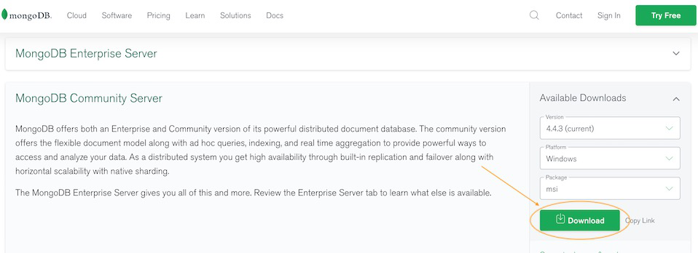
Installation and configuration of MongoDB
Step 1: Go to MongoDB Download Center to download MongoDB Community Server. Here, You can select any version, Windows, and package according to your requirement

Slide 13
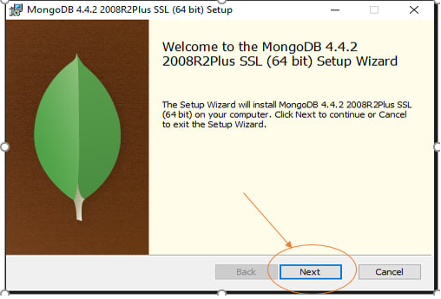
Contn…
Step 2: When the download is complete open the msi file and click the next button in the startup screen:

Slide 14
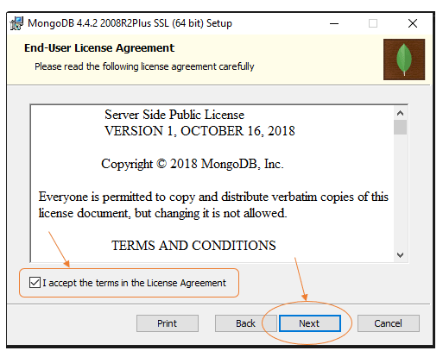
Contn…
Step 3: Now accept the End-User License Agreement and click the next button

Slide 15
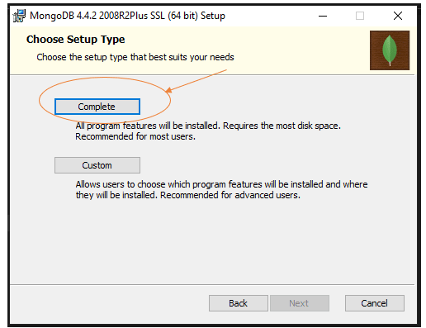
Contn…
Step 4: Now select the complete option to install all the program features. Here, if you can want to install only selected program features and want to select the location of the installation, then use the Custom option:

Slide 16
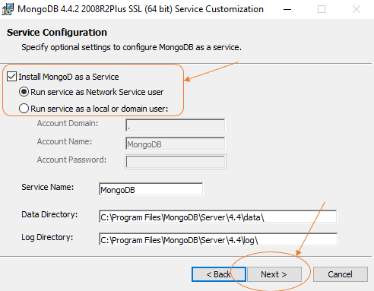
Contn…
Step 5: Select “Run service as Network Service user” and copy the path of the data directory. Click Next

Slide 17
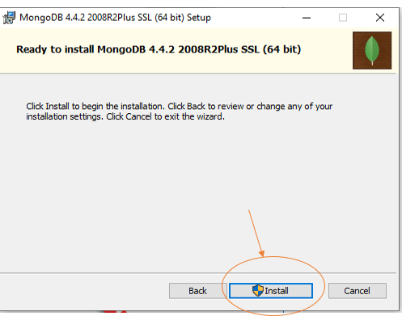
Contn…
Step 6: Click the Install button to start the installation process and then click Finish:

Slide 18
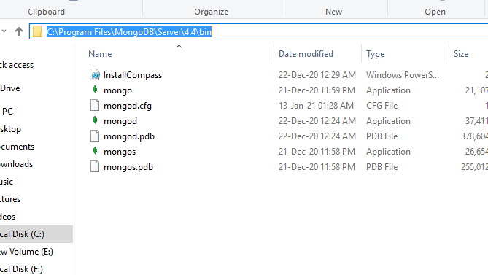
Contn…
Step 7: Now we go to the location where MongoDB installed in step 5 in your system and copy the bin path:

Slide 19
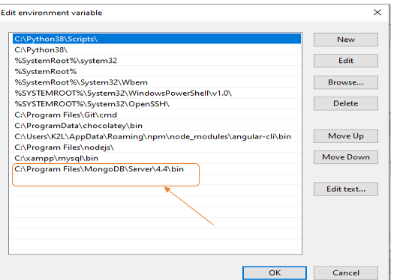
Contn…
Step 8: Now, to create an environment variable open system properties << Environment Variable << System variable << path << Edit Environment variable and paste the copied link to your environment system and click Ok:

Slide 20
mongod
mongod
mongod
Contn…
Step 9: Now, Open C drive and create a folder named “data” inside this folder create another folder named “db”. After creating these folders. open the command prompt and run the following command:
Command: mongod
the MongoDB server(i.e., mongod) will run successfully.

Slide 21
mongod
mongod
mongod
Contn…
Step 10: Now we are going to connect our server (mongod) with the mongo shell. So, keep that mongod window and open a new command prompt window and write mongo. Now, our mongo shell will successfully connect to the mongod.
Important Point: Please do not close the mongod window if you close this window your server will stop working and it will not able to connect with the mongo shell.
Now, you are ready to write queries in the mongo Shell

Slide 22
CRUD in MongoDB
CREATE, READ, UPDATE, and DELETE actions are referred to as CRUD operations in MongoDB. These are the basic operations used to alter data in databases. In MongoDB, the term "CRUD operations" refers to the standard set of database operations used to work with collections of data.
Create: To add new documents to a collection, use the Create operation.
Read: Data from a collection is retrieved using the Read operation.
Update: The Update operation is used to edit existing documents in a collection.
Delete: A collection of documents can be deleted using the Delete procedure.

Slide 23
Contn…
To create a new database, you can simply run any command against a non-existing database, and MongoDB will automatically create it for you.
If Database already exist then it use same existing database
Let us create a database name test
use test; (execute this command to create database)

Slide 24
Contn…
Creating a New Collection:
To create a new collection, you can use the "createCollection" method.
Syntax: db.createCollection(name, options)
eg:
db.createCollection(“dummy")

Slide 25
Contn…
Create Operation
There are two ways to create new documents to a collection in MongoDB:
1. insertOne():
Adding a single document to a collection is done using this method. A document to be added is the only argument it accepts, and it returns a result object with details about the insertion.
Syntax: db.collectionName.insertOne()
eg:
db.dummy.insertOne({
name: “RAM",
age: 25,
…
});

Slide 26
Contn…
2. insertMany()
This method is used to insert multiple documents into a collection at once. It takes an array of documents as its argument and returns a result object that contains information about the insertion.
Syntax: db.collectionName.insertMany();
eg:
db.users.insertMany([
{
name: “Ram",
age: 27,
},
{
name: “Sham",
age: 30,
},
]);

Slide 27
Contn…
Read Operations
In MongoDB, read operations are used to retrieve data from the database.
1. find()
The find() method is used to retrieve data from a collection. It returns a cursor that can be iterated to access all the documents that match the specified query criteria.
Syntax: db.collectionName.find(query, projection)
Eg:
1. db.dummy.find()
2. db.dummy.find({ age: { $gt: 29 } }, { name: 1, age: 1 })
This command will return all the documents in the “dummy" collection where the age is greater than 29, and only return the "name" and "age" fields.

Slide 28
Contn…
2. findOne()
The findOne() method returns a single document object, or null if no document is found. You can pass a query object to this method to filter the results.
Syntax: db.collectionName.findOne()
Eg:
db.dummy.findOne({ name: “Ram" })

Slide 29
Contn…
1. limit() Method:
Limits the number of documents returned by a MongoDB query.
query: db.students.find().limit(5);
Limits the result set to the first 5 documents returned by the query.
2. skip() Method:
Skips a specified number of documents in a MongoDB query result set.
query:db.students.find().skip(10);
Skips the first 10 documents in the result set, returning the subsequent documents.

Slide 30
Contn…
Update Operations
In MongoDB, the "update" operation is used to modify existing documents in a collection.
1. updateOne()
The updateOne() method is used to update a single document that matches a specified filter.
Syntax: db.collectionName.updateOne(filter, update, options)
Eg:
db.dummy.updateOne({ name: “Ram" }, { $set: { age: “30" } })

Slide 31
Contn…
Following are a few of the many available operations:
$set: Sets the value of a field in a document. If the field does not exist, the set will create it.
$unset: Removes a field from a document.
$inc: Increments the value of a field in a document by a specified amount.
$push: Adds an element to the end of an array field in a document. If the field does not exist, push will create it as an array with the specified element.
$pull: Removes all occurrences of a specified value from an array field in a document.

Slide 32
Contn…
2. updateMany
The updateMany() method is used to update multiple documents that match a specified filter.
Syntax:
db.collectionName.updateMany(filter, update, options)
Eg:
db.dummy.updateMany({ age: { $lt: 30 } }, { $set: { age: 28} })
This command will update the status of all documents in the “dummy" collection where the age is less than 30 to age 28.

Slide 33
Contn…
3. replaceOne():
Replaces a single document with a new document.
db.students.replaceOne(
{ name: "Bob" },
{ name: "Bob", age: 29, grade: "A-" }
);

Slide 34
Contn…
Delete Operations
In MongoDB, the "delete" operation is used to remove documents from a collection.
There are several ways to perform a delete operation, including the following:
1. deleteOne()
The deleteOne() method is used to remove a single document that matches a specified filter.
Syntax: db.collectionName.deleteOne(filter, options)
Eg:
db.dummy.deleteOne({ name: “ram" })
This command will remove the first document in the “dummy" collection where the name is “ram"

Slide 35
Contn…
2. deleteMany()
The deleteMany() method is used to remove multiple documents that match a specified filter.
Syntax:
db.collectionName.deleteMany(filter, options)
Eg:
db.dummy.deleteMany({ age: { $lt: 30 } })
This command will remove all documents in the "users" collection where the age is less than 30

Slide 36
Contn…
3. drop()
The drop() method is used to remove an entire collection.
Syntax:
db.collectionName.drop()
Eg:
db.dummy.drop()
This command will remove the dummy collection.

Slide 37
Indexing and querying in MongoDB
Indexes support the efficient resolution of queries. Without indexes, MongoDB must scan every document of a collection to select those documents that match the query statement. This scan is highly inefficient and require MongoDB to process a large volume of data.
Indexes are special data structures, that store a small portion of the data set in an easy-to-traverse form. The index stores the value of a specific field or set of fields, ordered by the value of the field as specified in the index.
To create an index, you need to use createIndex() method of MongoDB.
Syntax: db.collectionName.createIndex({KEY:1})

Slide 38
Contn…
Here key is the name of the field on which you want to create index and 1 is for ascending order. To create index in descending order you need to use -1.
Eg; db.dummy.createIndex({“title”:1})
In createIndex() method you can pass multiple fields, to create index on multiple fields.
Eg; db.dummy.createIndex({“title”:1, “description”:1})

Slide 39
Contn…
The dropIndex() method
You can drop a particular index using the dropIndex() method of MongoDB.
Syntax: Eg; db.collectionName.dropIndex({“KEY”:1})
Eg: Eg; db.dummy.createIndex({“title”:1})

Slide 40
Schema design and data modeling
MongoDB Schema Design
Now, MongoDB schema design works a lot differently than relational schema design. With MongoDB schema design, there is:
No formal process
No algorithms
No rules

Slide 41
Schema design and data modeling
When you are designing your MongoDB schema design, the only thing that matters is that you design a schema that will work well for your application. Two different apps that use the same exact data might have very different schemas if the applications are used differently. When designing a schema, we want to take into consideration the following:
Store the data
Provide good query performance
Require reasonable amount of hardware

Slide 42
Schema design and data modeling
{
_id: POST_ID
title: TITLE_OF_POST,
description: POST_DESCRIPTION,
by: POST_BY,
url: URL_OF_POST,
tags: [TAG1, TAG2, TAG3],
likes: TOTAL_LIKES,
comments: [
{
user: 'COMMENT_BY',
message: TEXT,
datecreated: DATE_TIME,
like: LIKES
},
{
user: 'COMMENT_BY',
message: TEST,
dateCreated: DATE_TIME,
like: LIKES
}}}

Slide 43
Schema design and data modeling
You can see that instead of splitting our data up into separate collections or documents, we take advantage of MongoDB's document based design to embed data into arrays and objects within the User object. Now we can make one simple query to pull all that data together for our application.

Slide 44
Schema design and data modeling
MongoDB schema design actually comes down to only two choices for every piece of data. You can either embed that data directly or reference another piece of data using the $lookup operator (similar to a JOIN). Let's look at the pros and cons of using each option in your schema.
1.Embedding
You can retrieve all relevant information in a single query.
Avoid implementing joins in application code or using $lookup.
Update related information as a single atomic operation.

Slide 45
Schema design and data modeling
2. Referencing
The other option for designing our schema is referencing another document using a document's unique ID and connecting them together using the $lookup operator. Referencing works similarly as the JOIN operator in an SQL query. It allows us to split up data to make more efficient and scalable queries, yet maintain relationships between data.
By splitting up data, you will have smaller documents.
Infrequently accessed information not needed on every query.
Reduce the amount of duplication of data. However, it's important to note that data duplication should not be avoided if it results in a better schema.

Slide 46
Schema design and data modeling
Type of Relationships
1.One-to-one
Using embedded documents we can create one-to-one relationships between the data so, that we can easily retrieve data using few read operations
// Student document { StudentName: Ishan,
StudentId: 123_2022,
Branch:CSE }
// Address document
{ StudentName: Ishan,
PremanentAddress: XXXXXXX,
City: Jaipur,
PinCode:302022 }

Slide 47
Schema design and data modeling
If the address data is frequently used, the user creates a query using Student Name to retrieve the data from the address document. However, because two documents contain the same field (i.e., StudentName), the user must write a few more queries to retrieve the required information. This data retrieval procedure is time-consuming. As a result, the address document was embedded in the student document.
{
StudentName: Ishan,
StudentId: 123_2020,
Branch:CSE
PermanentAddress:{
PremanentAddress:XXXXXXX,
City: Jaipur,
PinCode:302022 } }

Slide 48
Schema design and data modeling
2. One-to-Many
We can create one-to-many relationships between data using embedded documents, allowing us to retrieve data quickly with few read operations. With the help of an example, we will now discuss the one-to-many relationship with embedded documents.

Slide 49
Schema design and data modeling
2. One-to-Many
// Student document
{ StudentName: Ishan,
StudentId: 123_2022,
Branch:CSE
}
// Permanent Address document
{ StudentName: Ishan,
PermanentAddress: XXXXXXX,
City: Jaipur,
PinCode:302022 }
// Current Address document
{
StudentName: Ishan,
CurrentAddress: XXXXXXX,
City: Kota,
PinCode:324001 }

Slide 50
Schema design and data modeling
Instead of writing three documents, we can now combine them into one.
// Student document
{ StudentName: ishan,
StudentId: k_hut_2022,
Branch:CSE
Address: [
{
StudentName: Ishan,
PermanentAddress: XXXXXXX,
City: Jaipur,
PinCode:302022
}, {
StudentName: Ishan,
CurrentAddress: XXXXXXX,
City: kota,
PinCode:324001 } ] }

Slide 51
Schema design and data modeling
One-to-Many relationships with the document reference
The document reference model can also be used to create a one-to-many relationship. We keep the documents separate in this model, but one document contains the references to the others.
A Many-to-Many relationship
Many to Many relationships are a type of mongodb relationship in which any two entities within a document can have multiple relationships.
In this relationship, we can consider a case of Online courses website where there are many courses and also many users. Each course is purchased by many users and each user may purchase many courses.

Slide 52
MongoDB Query Operators
Comparison
The following operators can be used in queries to compare values:
$eq | Matches values that are equal to the given value.
$gt | Matches if values are greater than the given value.
$lt | Matches if values are less than the given value.
$gte | Matches if values are greater or equal to the given value.
$lte | Matches if values are less or equal to the given value.
$in | Matches any of the values in an array.
$ne | Matches values that are not equal to the given value.
$nin | Matches none of the values specified in an array

Slide 53
MongoDB Query Operators
Comparison
The following operators can be used in queries to compare values:
$eq | Matches values that are equal to the given value.
$gt | Matches if values are greater than the given value.
$lt | Matches if values are less than the given value.
$gte | Matches if values are greater or equal to the given value.
$lte | Matches if values are less or equal to the given value.
$in | Matches any of the values in an array.
$ne | Matches values that are not equal to the given value.
$nin | Matches none of the values specified in an array

Slide 54
MongoDB Query Operators
Logical
The following operators can logically compare multiple queries.
$and | Joins two or more queries with a logical AND and returns the documents that match all the conditions.
$or | Join two or more queries with a logical OR and return the documents that match either query.
$nor | The opposite of the OR operator. The logical NOR operator will join two or more queries and return documents that do not match the given query conditions.
$not | Returns the documents that do not match the given query expression.

Slide 55
MongoDB Aggrigation
In MongoDB, aggregation operations process the data records/documents and return computed results. It collects values from various documents and groups them together and then performs different types of operations on that grouped data like sum, average, minimum, maximum, etc to return a computed result.
MongoDB provides three ways to perform aggregation
Aggregation pipeline
Map-reduce function
Single-purpose aggregation

Slide 56
Aggrigation Pipeline
In MongoDB, the aggregation pipeline consists of stages and each stage transforms the document. Or in other words, the aggregation pipeline is a multi-stage pipeline, so in each state, the documents taken as input and produce the resultant set of documents now in the next stage the resultant documents taken as input and produce output, this process is going on till the last stage. The basic pipeline stages provide filters that will perform like queries and the document transformation modifies the resultant document and the other pipeline provides tools for grouping and sorting documents.

Slide 57
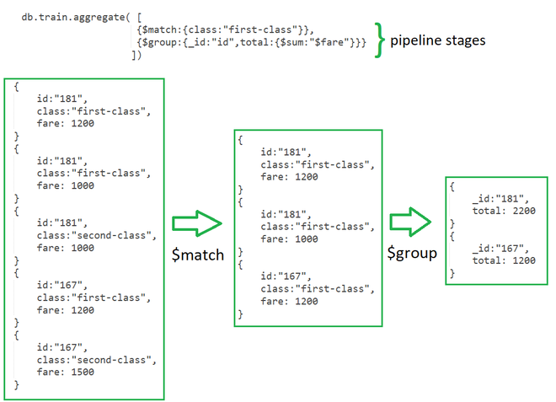
Aggrigation Pipeline

Slide 58
Aggrigation Pipeline
In the previous example of a collection of train fares in the first stage. Here, the $match stage filters the documents by the value in class field i.e. class: “first-class” and passes the document to the second stage.
In the Second Stage, the $group stage groups the documents by the id field to calculate the sum of fare for each unique id.

Slide 59
Aggrigation Pipeline
Stages: Each stage starts from stage operators which are:
1. $match: It is used for filtering the documents can reduce the amount of documents that are given as input to the next stage.
2. $project: It is used to select some specific fields from a collection.
3. $group: It is used to group documents based on some value.
4. $sort: It is used to sort the document that is rearranging them

Slide 60
Aggrigation Pipeline
5. $skip: It is used to skip n number of documents and passes the remaining documents
6. $limit: It is used to pass first n number of documents thus limiting them.
7. $unwind: It is used to unwind documents that are using arrays i.e. it deconstructs an array field in the documents to return documents for each element.
8. $out: It is used to write resulting documents to a new collection.

Slide 61
Aggrigation Pipeline
Expressions: It refers to the name of the field in input documents for e.g. { $group : { _id : “$id“, total:{$sum:”$fare“}}} here $id and $fare are expressions.
Accumulators: These are basically used in the group stage
1. sum: It sums numeric values for the documents in each group
2. count: It counts total numbers of documents

Slide 62
Aggrigation Pipeline
3. avg: It calculates the average of all given values from all documents
4. min: It gets the minimum value from all the documents
5. max: It gets the maximum value from all the documents
6. first: It gets the first document from the grouping
7. last: It gets the last document from the grouping

Slide 63
Aggrigation Pipeline
db.dummy.aggregate([
// Stage 1: Only find documents that have more than 1 like
{
$match: { likes: { $gt: 1 } }
},
// Stage 2: Group documents by category and sum each categories likes
{
$group: { _id: "$category", totalLikes: { $sum: "$likes" } }
}
])

Slide 64
Aggrigation Pipeline
db.restaurants.aggregate([
{
$project: {
"name": 1,
"cuisine": 1,
"address": 1
}
},
{
$limit: 5
}
])

Slide 65
Aggrigation Pipeline
db.listingsAndReviews.aggregate([
{
$sort: { "accommodates": -1 }
},
{
$project: {
"name": 1,
"accommodates": 1
}
},
{
$limit: 5
}
])

Slide 66
Aggrigation Pipeline
db.listingsAndReviews.aggregate([
{ $match : { property_type : "House" } },
{ $limit: 2 },
{ $project: {
"name": 1,
"bedrooms": 1,
"price": 1
}}
])

Slide 67
Aggrigation Pipeline
$addField: This will return the documents along with a new field, avgGrade, which will contain the average of each restaurants grades.score.
db.restaurants.aggregate([
{
$addFields: {
avgGrade: { $avg: "$grades.score" }
}
},
{
$project: {
"name": 1,
"avgGrade": 1
}
}])

Slide 68
Aggrigation Pipeline
$lookup: This aggregation stage performs a left outer join to a collection in the same database.
from: The collection to use for lookup in the same database
localField: The field in the primary collection that can be used as a unique identifier in the from collection.
foreignField: The field in the from collection that can be used as a unique identifier in the primary collection.
as: The name of the new field that will contain the matching documents from the from collection.

Slide 69
Aggrigation Pipeline
db.comments.aggregate([
{
$lookup: {
from: "movies",
localField: "movie_id",
foreignField: "_id",
as: "movie_details",
},
},
{
$limit: 1
}
])

Slide 70
Aggrigation Pipeline
1. findOneAndUpdate():
Finds a single document that matches a specified query criteria, updates it, and returns the original or modified document.
example:
const result = db.students.findOneAndUpdate(
{ name: "Alice" }, // Query criteria
{ $set: { grade: "A+" } }, // Update operation
{ returnDocument: "after" } // Options to return the modified document
);
printjson(result.value);

Slide 71
Aggrigation Pipeline
1. findOneAndUpdate():
Finds a single document that matches a specified query criteria, updates it, and returns the original or modified document.
example:
const result = db.students.findOneAndUpdate(
{ name: "Alice" }, // Query criteria
{ $set: { grade: "A+" } }, // Update operation
{ returnDocument: "after" } // Options to return the modified document
);
printjson(result.value);

Slide 72
Aggrigation Pipeline
2. findOneAndDelete():
Finds a single document that matches a specified query criteria, deletes it, and returns the original or deleted document.
example
const result = db.students.findOneAndDelete(
{ name: "Bob" } // Query criteria
);

Slide 73
Aggrigation Pipeline
3. findOneAndReplace():
Finds a single document that matches a specified query criteria, replaces it with a new document, and returns the original or replaced document.
const result = db.students.findOneAndReplace(
{ name: "Charlie" }, // Query criteria
{ name: "Charlie", age: 24, grade: "A-" }, // Replacement document
{ returnDocument: "before" } // Options to return the original document
);

Slide 74


www.paruluniversity.ac.in

